Slide 1
Lending Club Case Study
By
Sathish Kumar Mani

Slide 2
Problem Statement
Lending Club company wants to understand the driving factors (or variables) behind loan default, i.e. factors strongly associated with default. This knowledge can be used for portfolio management and risk assessment on the bad loan by the company.

Slide 3
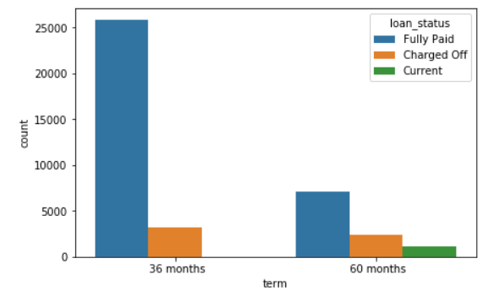
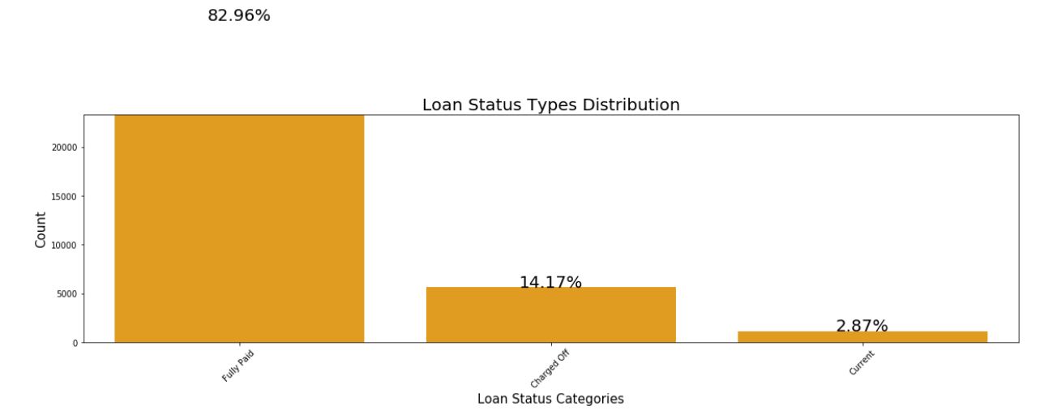
Analysis and Conclusion
In order to make a thorough analysis of the data, let us start by stating that almost 83 % of the loans availed were fully paid and only 14% of the loans were charged off. When the repayment period is 36 months, the chances of repaying the loan are good.

Slide 4
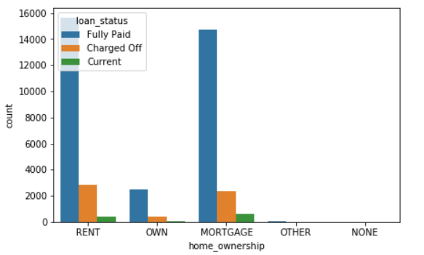
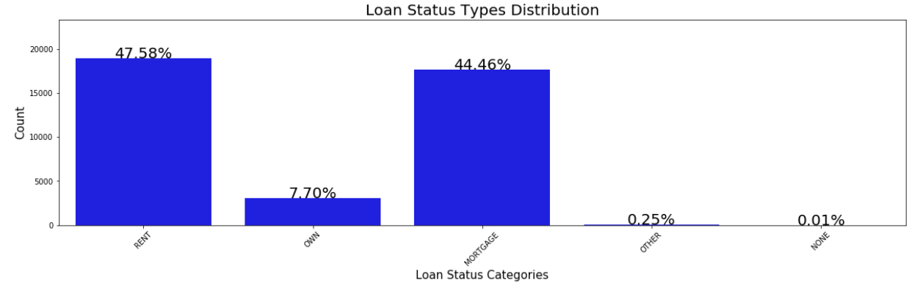
Analysis and Conclusion
It has been found that most of the borrowers are from rented homes and homeowners with mortgages and that charge-off cases are more prevalent among rented home borrowers.

Slide 5
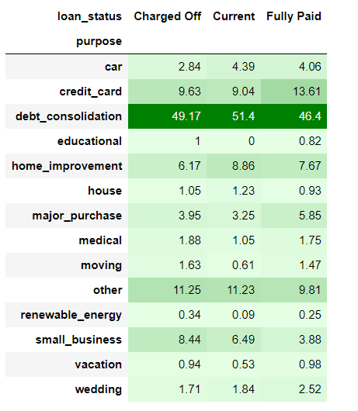
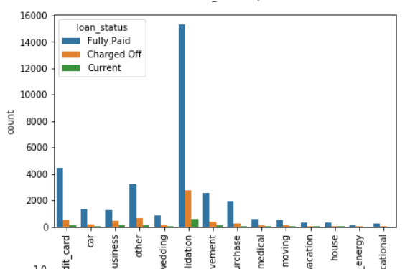
Analysis and Conclusion
It is recommended that the company should cross-check the borrowers if the purpose of the loan is to consolidate debt, as there is a substantial risk of default.

Slide 6
Analysis and Conclusion
The fourth conclusion is that borrowers who take loans for a wedding, car, credit card, house improvement, or major purchase look promising since they have good repayment capacity.

Slide 7
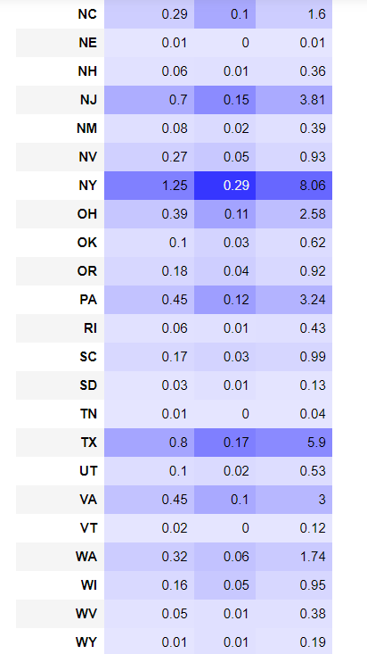
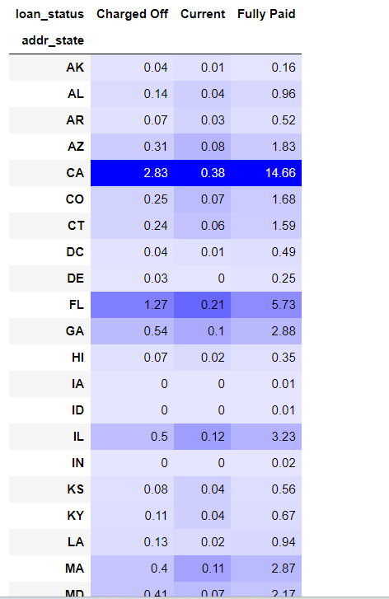
Analysis and Conclusion
The interesting point is there are some states which contribute more in borrowing and the business can be expanded on those regions, to name a few, CA, TX, NY, etc

Slide 8
Thank you

